Slide 1
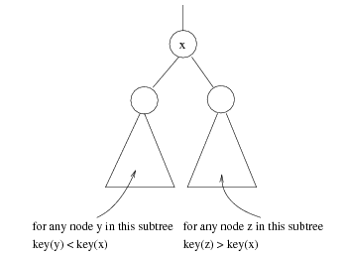
Binary Search Trees (BST)
A data structure for efficient searching, insertion and deletion.
Binary search tree property
  For every node X
  All the keys in its left
  subtree are smaller than
  the key value in X
  All the keys in its right
  subtree are larger than the
  key value in X

Slide 2

Binary Search Trees
A binary search tree
Not a binary search tree

Slide 3

Binary Search Trees
Average depth of a tree is O(log N)
Maximum depth of a tree is O(N)
The same set of keys may have different BSTs

Slide 4
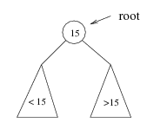
Searching BST
If we are searching for 15, then we are done.
If we are searching for a key < 15, then we should search in the left sub-tree.
If we are searching for a key > 15, then we should search in the right sub-tree.

Slide 5
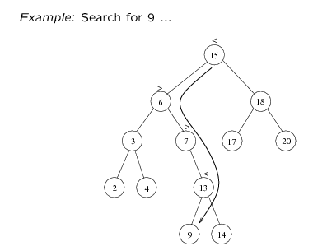
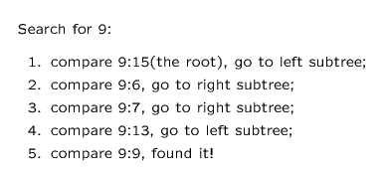

Slide 6
BST(searching)
FIND (INFO, LEFT, RIGHT, ROOT, ITEM, LOC, PAR)
If ROOT=NULL then:
Set LOC:=NULL and PAR:=NULL and return
2) If ITEM=INFO[ROOT],then:
Set LOC:=ROOT and PAR:=NULL and return
If ITEM<INFO[ROOT],then:
Set PTR:=LEFT[ROOT] and SAVE:=ROOT
Else:
Set PTR:=RIGHT[ROOT] and SAVE:=ROOT
4) Repeat step 5 and 6 while PTR≠NULL
If ITEM=INFO[PTR] then:
  Set LOC:=PTR and PAR:=SAVE and return
If ITEM<INFO[PTR],then:
Set SAVE:=PTR and PTR:=LEFT[PTR]
Else:
Set SAVE:=PTR and PTR:=RIGHT[PTR]
7) Set LOC:=NULL and PAR:=SAVE
8) Exit

Slide 7
BST(Insertion)
INSBST (INFO, LEFT, RIGHT, ROOT, AVAIL, ITEM, LOC)
Call FIND(INFO,LEFT,RIGHT,ROOT,ITEM,LOC,PAR)
If LOC != NULL, then Exit
3) a) if AVAIL=NULL then :
write OVERFLOW and exit
b) Set NEW:=AVAIL, AVAIL:=LEFT[AVAIL] and INFO[NEW]:=ITEM
c) Set LOC:=NEW , LEFT[NEW]:=NULL and RIGHT[NEW]:=NULL
4) If PAR=NULL then:
Set ROOT:=NEW
else if: ITEM<INFO[PAR] then:
Set LEFT[PAR]:=NEW
else :
Set RIGHT[PAR]:=NEW
5) exit

Slide 8
BST (Deletion)
CaseA (Info, Left, Right, Root, Loc, Par)
This procedure deletes node N at location Loc, where N doesn’t have 2 children. Par=Null → N is root node; Child=Null → N has no child
[Initilizes Child]
If Left[Loc]= Null and Right[Loc] = Null, then
Set Child = Null
Else if Left[Loc] ≠ Null, then
Set Child = Left[Loc]
Else
Set Child = Right[Loc]
2) If Par ≠ Null, then
If Loc = Left[Par], then Set Left[Par] = Child
Else Set Right[Par] = Child
Else Set Root = Child
3) Return

Slide 9
BST (Deletion)
CaseB(Info, Left, Right, Root, Loc, Par)
This procedure deletes node N at location Loc, where N has 2 children. Par=Null → N is root node; Suc → inorder successor, ParSuc → Parent of inorder successor
[Find Suc and ParSuc]
  Set Ptr = Right[Loc] and Save = Loc
  Repeat while Left[Ptr] ≠ Null
  Set Save = Ptr and Ptr = Left[Ptr]
  Set Suc = Ptr and ParSuc = Save
[Delete inorder successor using Procedure of CaseA]
Call CaseA (Info, Left, Right, Root, Suc, ParSuc)
[Replace Node N by its inorder successor]
  a) If Par ≠ Null, then
  If Loc = Left[Par], then Set Left[Par] = Suc
  Else Set Right[Par] = Suc
  Else Set Root = Suc
  Set Left[Suc] = Left[Loc] and Right[Suc] = Right[Loc]
4) Return

